Slide 1
Process Synchronization

Slide 2

Motivating Scenario
shared variable
program 0
int counter=5;
program 1
{
*
* counter++
*
}
{
*
* counter--
*
}
•
Single core
– Program 1 and program 2 are executing at the same time but sharing a single core
1
2
1
2
1
2
1 2
CPU usage wrt time
Source: http://www.cse.iitm.ac.in/~chester/courses/15o_os/syllabus.html

Slide 3
Motivating Scenario
Shared variable
program 0
int counter=5;
program 1
{
*
* counter++
*
}
{
*
* counter--
*
}
What is the value of counter?
expected to be 5
but could also be 4 and 6
Source: http://www.cse.iitm.ac.in/~chester/courses/15o_os/syllabus.html

Slide 4
Motivating Scenario
Shared variable
program 0
int counter=5;
program 1
{
*
*
counter++
*
}
{
*
* counter--
*
}
R1 ← counter R1 ← R1 + 1
counter ←R1
 | R1 ← counter
 | R2 ⇓ counter R2 ⇓R2 - 1 counter ⇓R2
 | R1 ← R1 + 1 counter ← R1
 | R1 ⇓ counter
 | R2 ← counter R2 ←R2 + 1 counter ←R2
 | R1 ⇓ R1 - 1 counter ⇓ R1
context switch
R2 ⇓ counter R2 ⇓ R2 - 1
counter ⇓R2
counter = 5
counter = 6
counter = 4
Source: http://www.cse.iitm.ac.in/~chester/courses/15o_os/syllabus.html

Slide 5
Race Conditions
•
Race conditions
A situation where several processes access and manipulate the same data (critical section)
The outcome depends on the order in which the access take place
Prevent race conditions by synchronization
Ensure only one process at a time manipulates the critical data
 | { * *
 | counter++
 | * }
critical section
No more than one process should execute in critical section at a time
Source: http://www.cse.iitm.ac.in/~chester/courses/15o_os/syllabus.html

Slide 6

Race Conditions in Multicore
shared variable
program 0
int counter=5;
program 1
{
*
* counter++
*
}
{
*
* counter--
*
}
•
Multi core
– Program 1 and program 2 are executing at the same time on different cores
1
2
CPU usage wrt time
Source: http://www.cse.iitm.ac.in/~chester/courses/15o_os/syllabus.html

Slide 7
Solution To Critical Section Problem
1. Mutual Exclusion - If process P_{i} is executing in its critical section, then no other processes can be executing in their critical sections
2. Progress - If no process is executing in its critical section and there exist some processes that wish to enter their critical section, then the selection of the processes that will enter the critical section next cannot be postponed indefinitely
3. Bounded Waiting - A bound must exist on the number of times that other processes are allowed to enter their critical sections after a process has made a request to enter its critical section and before that request is granted
Assume that each process executes at a nonzero speed
No assumption concerning relative speed of the n processes

Slide 8
First Version of Dekker’s Alg
program versionone;
var processnumber: integer;
Succeeds in enforcing the mutual exclusion.
The processor’s must enter and exit their critical sections in strict alteration (so inefficient).
Enforces lockstep synchronization problem.
procedure processone;
begin
while true do
begin
while processnumber=2 do;
critical_section_one;
processnumber:=2;
otherstuffone
end
end;
procedure procestwo;
begin
while true do
begin
while processnumber=1 do;
critical_section_two;
processnumber:=1;
otherstufftwo
end
end;
begin
processnumber:=1;
parbegin
processone;
processtwo
parend
end;

Slide 9
Second Version of Dekker’s Alg
program versiontwo;
var p1inside, p2inside : boolean;
procedure processone;
begin
while true do
begin
while p2inside do;
p1inside:=true;
critical_section_one;
p1inside:=false;
otherstuffone
end
end;
procedure procestwo;
begin
while true do
begin
while p1inside do;
p2inside:=true;
critical_section_two;
p2inside:=false;
otherstufftwo
end
end;
begin
p1inside:=false;
p2inside:=false;
parbegin
processone;
processtwo
parend
end;
Mutual exclusion is not guaranteed
statements are generally atomic, but series of statements are not

Slide 10
Mutual exclusion is guaranteed.
Introduces two-process deadlock.
Version 3

Slide 11
Mutual exclusion is guaranteed.
Deadlock cannot occur.
Indefinite postponement could occur.
Version 4 is unacceptable.
Version 4

Slide 12
Dekker’s algorithm of ME Primitive

Slide 13
Dekker’s algorithm of ME Primitive
Mutual exclusion guaranteed.
Lockstep Synchronization not enforced.
Deadlock is avoided.
Resolves possibility of indefinite postponement.

Slide 14

Peterson’s Solution
globally defined
p2_wants_to_enter, p1_wants_to_enter, favored
Process 1
while(1){
p1_wants_to_enter = True favored = 2
If the second process wants to enter. favor it. (be nice !!!)
lock
while (p2_wants_to_enter AND favored = 2);
critical section p1_wants_to_enter = False other code
favored is used to break the tie when both p1 and p2 want to enter the critical section.
(* the process which sets favored last looses the tie *)
unlock }
Break the tie with a ‘favored’ process
Source: http://www.cse.iitm.ac.in/~chester/courses/15o_os/syllabus.html

Slide 15
Peterson’s Solution (Two Process)
globally defined
p2_wants_to_enter, p1_wants_to_enter, favored
Process 1
Process 2
while(1){
p1_wants_to_enter = True favored = 2
while (p2_wants_to_enter AND favored == 2);
critical section p1_wants_to_enter = False other code
}
while(1){
p2_wants_to_enter = True favored = 1
while (p1_wants_to_enter AND favored == 1);
critical section p2_wants_to_enter = False other code
}
Refer Section 6.3 (from text book) for N process solution.
Source: http://www.cse.iitm.ac.in/~chester/courses/15o_os/syllabus.html

Slide 16
Synchronization Hardware
Many systems provide hardware support for implementing the critical section code.
All solutions below based on idea of locking
Protecting critical regions via locks
Uniprocessors – could disable interrupts
Currently running code would execute without preemption
Generally too inefficient on multiprocessor systems
Operating systems using this not broadly scalable
Modern machines provide special atomic hardware instructions
Atomic = non-interruptible
Either test memory word and set value
Or swap contents of two memory words

Slide 17
Using Interrupts
Process 1
Process 2
 | while(1){
 |  | disable interrupts () critical section enable interrupts () other code
 | }
while(1){
disable interrupts () critical section enable interrupts () other code
}
lock
unlock
Simple
When interrupts are disabled, context switches won’t happen
Requires privileges
User processes generally cannot disable interrupts
Not suited for multicore systems
Source: http://www.cse.iitm.ac.in/~chester/courses/15o_os/syllabus.html

Slide 18
Analyze this
•
Does this scheme provide mutual exclusion?
Process 1
Process 2
while(1){ while(lock != 0); lock= 1; // lock critical section
lock = 0; // unlock other code
}
while(1){ while(lock != 0); lock = 1; // lock critical section
lock = 0; // unlock
other code
}
 | lock = 0
 | P1: while(lock != 0);
 | P2: while(lock != 0); P2: lock = 1;
 | P1: lock = 1; …. Both processes in critical section
No
context switch
Source: http://www.cse.iitm.ac.in/~chester/courses/15o_os/syllabus.html

Slide 19
If only…
We could make this operation atomic
Process 1
while(1){
while(lock != 0); lock= 1; // lock critical section lock = 0; // unlock other code
}
Make atomic
Hardware to the rescue….
Source: http://www.cse.iitm.ac.in/~chester/courses/15o_os/syllabus.html

Slide 20
Hardware Support (Test & Set Instruction)
Write to a memory location, return its old value
atomic
while(1){ while(test_and_set(&lock) == 1); critical section
lock = 0; // unlock other code
}
int test_and_set(int *L){ int prev = *L;
*L = 1;
return prev;
}
equivalent software representation
(the entire function is executed atomically)
Usage for locking
Why does this work? If two CPUs execute test_and_set at the same time, the hardware ensures that one test_and_set does both its steps before the other one starts.
So the first invocation of test_and_set will read a 0 and set lock to 1 and return. The second test_and_set invocation will then see lock as 1, and will loop continuously until lock becomes 0
Source: http://www.cse.iitm.ac.in/~chester/courses/15o_os/syllabus.html

Slide 21
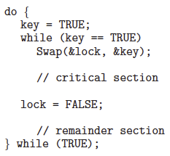
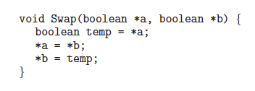
Hardware Support … (Swap)
Mutual-exclusion implementation with the Swap() instruction.
The definition of the Swap() instruction.
Refer Section 6.4 (from text book).

Slide 22
Hardware Solution…
Mutual exclusion is guaranteed/preserved.
Bounded waiting is not guaranteed. [ Refer Figure 6.8 (from text book) to handle this. ]
Advantages
Applicable to any number of processes on either a single processor or multiple processors sharing main memory.
It is simple and therefore easy to verify.
It can be used to support multiple critical sections.

Slide 23
Bounded-waiting Mutual Exclusion with test_and_set
do { waiting[i] = true; key = true; while (waiting[i] && key) //The variable waiting[i] can become false only if another process leaves its critical section;
key = test_and_set(&lock); //only one process could get key =False (which first time sets lock=True)
waiting[i] = false;
/* critical section */
j = (i + 1) % n;
while ((j != i) && !waiting[j]) //Check if any other process is waiting(in order)
j = (j + 1) % n;
if (j == i) //If NO other process is waiting, any process can do so including current process.
lock = false;
else
waiting[j] = false; //if so, set its waiting=False
/* remainder section */
} while (true);
boolean waiting[n];
boolean lock;
[Initialized to false]
while(1){ while(test_and_set(&lock) == 1); critical section
lock = 0; // unlock other code}

Slide 24
Semaphore
Hardware solutions are complicated and generally inaccessible to application programmers
OS designers build software tools to solve critical section problem
Semaphore is a synchronization tool that provides more sophisticated ways for process to synchronize their activities.
Semaphore S – integer variable
Can only be accessed via two indivisible (atomic) operations
wait() and signal()
Originally called P(); (from the Dutch proberen, “to test”) and V() (from the Dutch verhogen,, “to increment” )
Definition of the wait() operation
wait(S) {
while (S <= 0)
; // busy wait
S--;}
Definition of the signal() operation
signal(S) {
S++;}

Slide 25
Semaphore…
Counting semaphore – integer value can range over an unrestricted domain
Binary semaphore – integer value can range only between 0 and 1; can be simpler to implement
Also known as mutex locks
Mutual-exclusion implementation with Binary semaphore
Semaphore mutex; // initialized to 1
do {
wait (mutex);
// Critical Section
signal (mutex);
// remainder section
} while (TRUE);
Notes:
spool

Slide 26
Semaphore…
Case 1: To control access to a given resource
Semaphore is initialized to the number of resources
Semaphore Count =0;all resources are utilized
Case 2 : process synchronization
How to ensure S2 is executed only after S1 completes?
Process1
S1;
signal(synch)
Process2
wait(synch)
S2;
Process1
S1;
Process2
S2;
Disadvantage: Busy waiting thus wastes CPU cycles

Slide 27
Semaphore…
While a process is in its critical section, any other process that tries to enter its critical section must loop continuously in the entry code.
This type of semaphore is also called spinlock a because the process "spins" while waiting for the lock.
Busy waiting wastes CPU cycles that some other process might be able to use productively.
(Spinlocks do have an advantage in that no context switch is required when a process must wait on a lock, and a context switch may take considerable time)
To overcome the need for busy waiting, we can modify the definition of the wait() and signal() semaphore operations.
rather than engaging in busy waiting, the process can block itself. The block operation places a process into a waiting queue associated with the semaphore

Slide 28
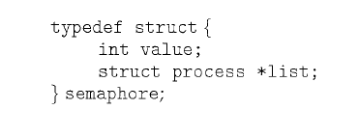
Semaphore Implementation with no Busy waiting
With each semaphore there is an associated waiting queue
Each entry in a waiting queue has two data items:
value (of type integer)
pointer to next record in the list
Two operations:
block – place the process invoking the operation on the appropriate waiting queue
wakeup – remove one of processes in the waiting queue and place it in the ready queue

Slide 29
Semaphore Implementation with no Busy waiting …
Synchronization tool that does not require busy waiting
Implementation of wait:
wait(semaphore *S) {
S->value--;
if (S->value < 0) {
add this process to S->list;
block();
} }
Implementation of signal:
signal(semaphore *S) {
S->value++;
if (S->value <= 0) {
remove a process P from S->list;
wakeup(P);
}}
Semaphore value –ve indicates the processes waiting to acquire that semaphore
Entry
Put the processes from the blocked list to ready queue
Exit

Slide 30
Deadlock and Starvation
Deadlock – two or more processes are waiting indefinitely for an event that can be caused by only one of the waiting processes
Let S and Q be two semaphores initialized to 1
P₀ P₁
wait (S); wait (Q);
wait (Q); wait (S);
. .
. .
. .
signal (S); signal (Q);
signal (Q); signal (S);
Starvation – indefinite blocking
A process may never be removed from the semaphore queue in which it is suspended
Priority Inversion – Scheduling problem when lower-priority process holds a lock needed by higher-priority process(occurs when a high priority task is indirectly preempted by a low priority task. )
Solved via priority-inheritance protocol

Slide 31
Classical Problems of Synchronization
Classical problems used to test newly-proposed synchronization schemes
Bounded-Buffer Problem
Readers and Writers Problem
Dining-Philosophers Problem

Slide 32
Bounded-Buffer Problem
N buffers, each can hold one item
Semaphore mutex initialized to the value 1
Semaphore full initialized to the value 0
Semaphore empty initialized to the value N
numberbuffer
Producer
Consumer

Slide 33
Bounded-Buffer Problem…
The structure of the consumer process
do {
wait (full);
wait (mutex);
// remove an item from buffer to nextc
signal (mutex);
signal (empty);
// consume the item in nextc
} while (TRUE);
The structure of the producer process
do { // produce an item in nextp
wait (empty);
wait (mutex);
// add nextp to buffer
signal (mutex);
signal (full);
} while (TRUE);

Slide 34

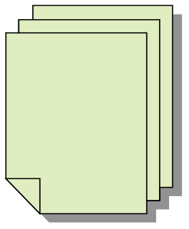



Readers-Writers Problem
Depending on the usage of the resource, processes are classified into either readers or writers.
A reader never modifies the shared data.
Writer may both read and write the shared data.
Readers may use the shared data concurrently.
Writers must be granted exclusive access to data.
Problem can be stated as below
Given universe of readers that read a shared data and universe of writers that modify the same shared data
Plan a synchronization protocol among the readers and writers that ensures data consistency while maintaining high degree of concurrency.
W
R
R
R

Slide 35
Readers-Writers Problem…
A data set is shared among a number of concurrent processes
Readers – only read the data set; they do not perform any updates
Writers – can both read and write
Problem – allow multiple readers to read at the same time
Only one single writer can access the shared data at the same time
Several variations of how readers and writers are considered – all involve some form of priorities
Shared Data
Semaphore mutex initialized to 1
Semaphore rw_mutex initialized to 1
Integer read_count initialized to 0
Notes:
Hoare (1974)
A new reader should not start if there is writer waitning to write
The readers waiting at the end of a write should have priority over the next writer

Slide 36
Readers-Writers Problem…
The structure of a reader process
do { wait(mutex); read_count++; if (read_count == 1)
wait(rw_mutex);
signal(mutex);
... /* reading is performed */
...
wait(mutex); read count--; if (read_count == 0)
signal(rw_mutex);
signal(mutex);
} while (true);
The structure of a writer process
do { wait(rw_mutex);
... /* writing is performed */
...
signal(rw_mutex);
} while (true);

Slide 37
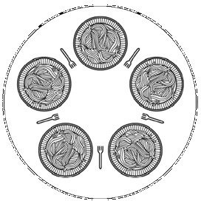
Dining Philosophers Problem
Philosophers either think or eat
Each need to use 2 forks for eating
We have only 5 forks
Problem Statement : Develop an algorithm where no philosopher starves.
A classical synchronization problem
Illustrates the difficulty of allocating resources among process without deadlock and starvation
E
5
1
A
D
4
2
3
C
B

Slide 38
Dining Philosophers Problem…
Process Pi:
repeat
think;
wait(fork[i]);
wait(fork[i+1 mod 5]);
eat;
signal(fork[i+1 mod 5]);
signal(fork[i]);
forever
Each philosopher is a process
One semaphore per fork:
fork: array[0..4] of semaphores
Initialization: fork[i].count:=1 for i:=0..4
A first attempt:
0
3
1
4
2
4
Deadlock if each philosopher start by picking his left fork!
2
3
0
1

Slide 39
Dining Philosophers Problem…
Possible solutions
Allow at most four philosophers to be sitting simultaneously at the table.
Allow a philosopher to pick up her chopsticks only if both chopsticks are available.
An odd philosopher picks up first her left chopstick and then her right chopstick. Where as an even philosopher picks up her right chopstick and then her left chopstick.
0
3
1
4
2
4
2
3
0
1

Slide 40
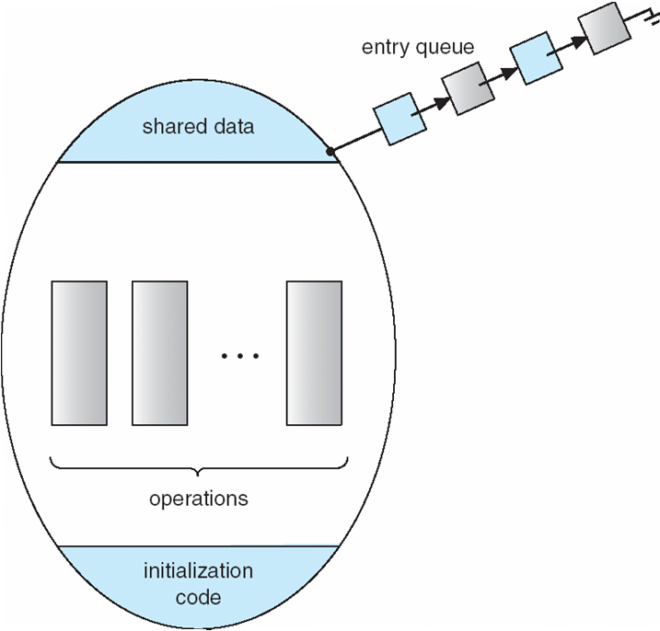
Monitors
Are high-level language constructs that provide equivalent functionality to that of semaphores but are easier to control
Found in many concurrent programming languages
Concurrent Pascal, Java etc.
Monitor is a software module containing:
one or more procedures
an initialization sequence
local data variables
monitor monitor-name
{
// shared variable declarations
procedure P1 (…) { …. }
…
procedure Pn (…) {……}
Initialization code ( ….) { … }
…
}
}

Slide 41
Monitors…
Characteristics:
local variables accessible only by monitor’s procedures
a process enters the monitor by invoking one of it’s procedures
only one process at a time can be active within the monitor .
The monitor ensures mutual exclusion: no need to program this constraint explicitly
The monitor locks the shared data on process entry.

Slide 42
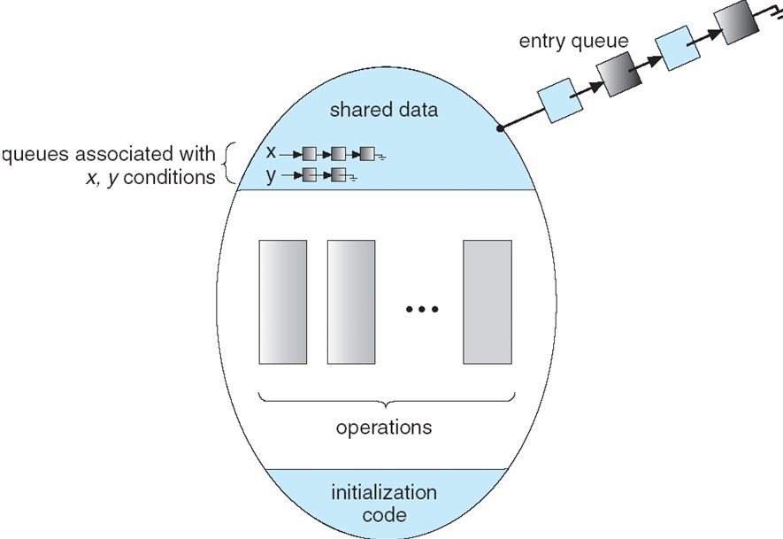
Monitors With Condn. Variable
To allow a process to wait within the monitor, a condition variable must be declared, as:
condition x, y;
Condition variable can only be used within the operations wait and signal. A queue is associated with each condition variable.
x.wait();
Means that the process invoking this operation is suspended until another process
invokes
x.signal();
The x.signal operation resumes exactly one suspended process. (that invoked x.wait) If no process is suspended, then the signal operation has no effect.

Slide 43
Solution to Dining Philosophers
DP.pickup(i)
…
Eat
….
DP.putdown(i)

Slide 44
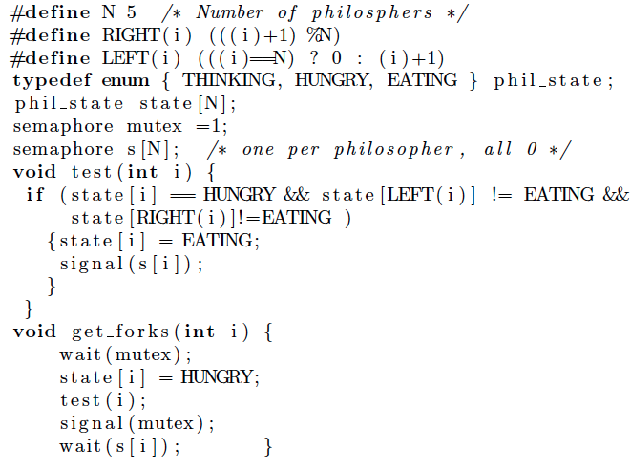
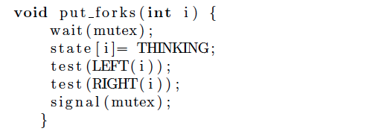
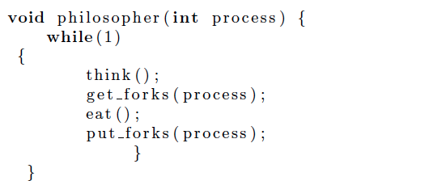
Solution to Dining Philosophers Using Semaphores

